Slide 1


Digital Signal Processing Final Term Presentation
Presented By:
SHASHANK MISHRA
D0829004
25th JUNE, 2020
Chang Gung University,
No.259, Wenhua 1st Rd., Guishan Dist., Taoyuan City 33302, Taiwan (R.O.C.)

Slide 2
Layout
Chapter's Solution
Research Progress
Chang Gung University,
No.259, Wenhua 1st Rd., Guishan Dist., Taoyuan City 33302, Taiwan (R.O.C.)

Slide 3
HARMONICS
Harmonics are unwanted higher frequencies which superimposed on the fundamental waveform creating a distorted wave pattern.
If you use Jupyter, load chap02.ipynb and try out the examples. You can also view the notebook at http://tinyurl.com/thinkdsp02
Chang Gung University,
No.259, Wenhua 1st Rd., Guishan Dist., Taoyuan City 33302, Taiwan (R.O.C.)

Slide 4
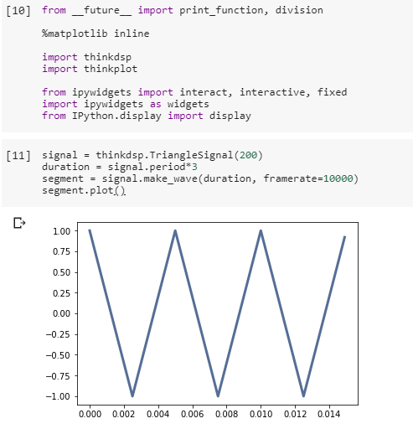
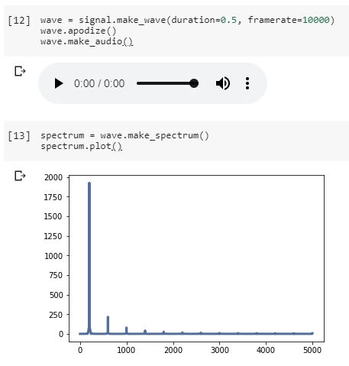
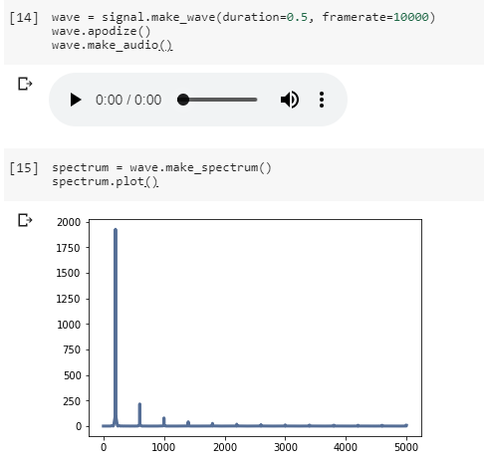
HARMONICS
Output Answer:
Chang Gung University,
No.259, Wenhua 1st Rd., Guishan Dist., Taoyuan City 33302, Taiwan (R.O.C.)

Slide 5
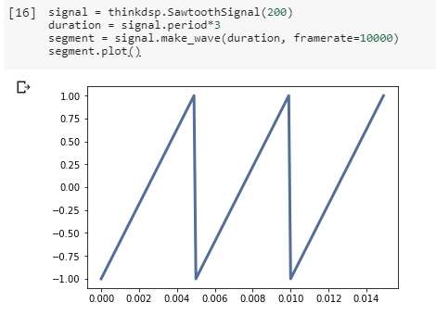
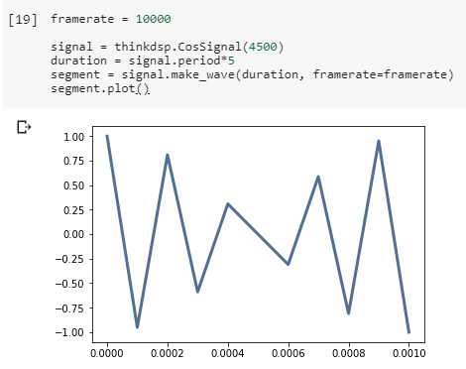
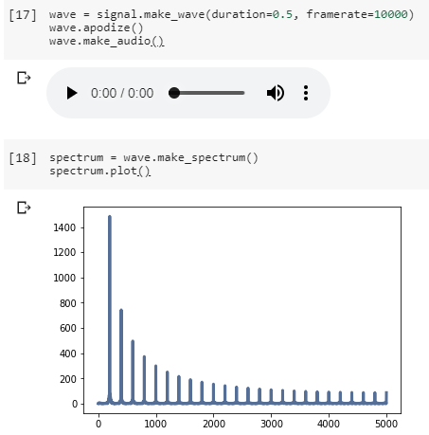
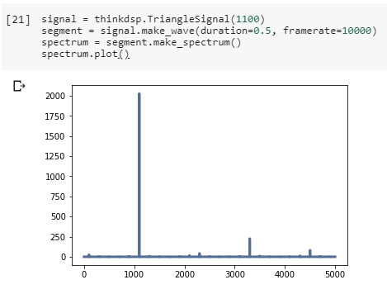
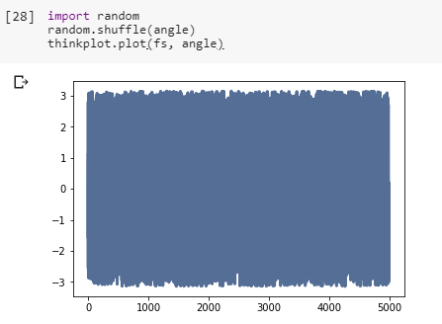
HARMONICS
Chang Gung University,
No.259, Wenhua 1st Rd., Guishan Dist., Taoyuan City 33302, Taiwan (R.O.C.)

Slide 6
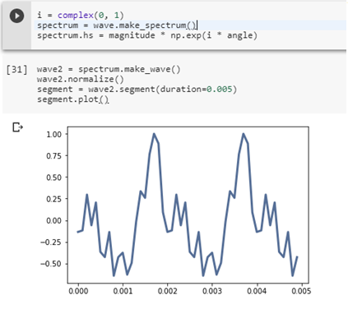
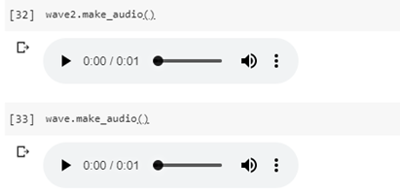
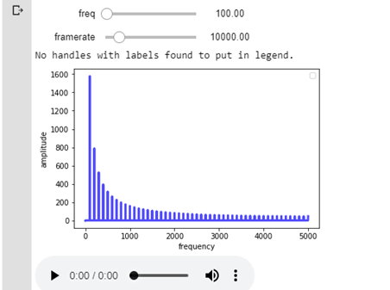
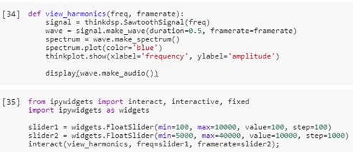
HARMONICS
Chang Gung University,
No.259, Wenhua 1st Rd., Guishan Dist., Taoyuan City 33302, Taiwan (R.O.C.)

Slide 7
NON-PERIODIC SIGNALS
A non-periodic signal is any signal that does not repeat itself after any period of time, however large that period may be. Most of the signals we come across in real life are non-periodic. For example, speech is a non-periodic signal.
Run and listen to the examples in chap03.ipynb, which is in the repository for this book, and also available at http://tinyurl.com/thinkdsp03. In the leakage example, try replacing the Hamming window with one of the other windows provided by NumPy, and see what effect they have on leakage. See http://docs.scipy.org/doc/numpy/reference/routines. window.html
Chang Gung University,
No.259, Wenhua 1st Rd., Guishan Dist., Taoyuan City 33302, Taiwan (R.O.C.)

Slide 8
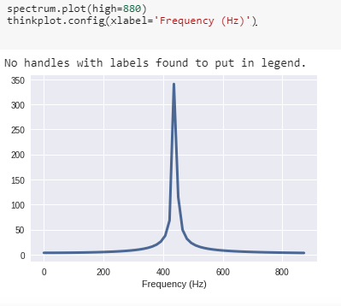
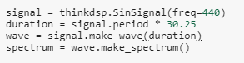
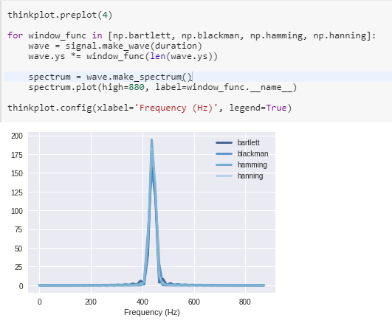
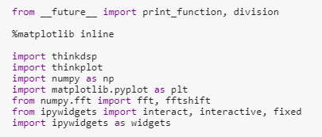
NON-PERIODIC SIGNALS
Chang Gung University,
No.259, Wenhua 1st Rd., Guishan Dist., Taoyuan City 33302, Taiwan (R.O.C.)

Slide 9
NOISE
A Soft Murmur” is a web site that plays a mixture of natural noise sources, including rain, waves, wind, etc. At http://asoftmurmur. com/about/ you can find their list of recordings, most of which are at http://freesound.org. Download a few of these files and compute the spectrum of each signal. Does the power spectrum look like white noise, pink noise, or Brownian noise? How does the spectrum vary over time?
Chang Gung University,
No.259, Wenhua 1st Rd., Guishan Dist., Taoyuan City 33302, Taiwan (R.O.C.)

Slide 10
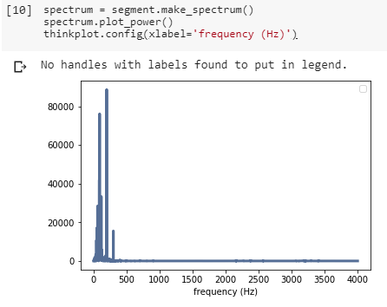
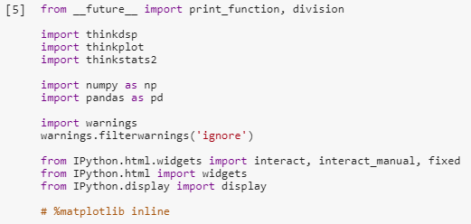
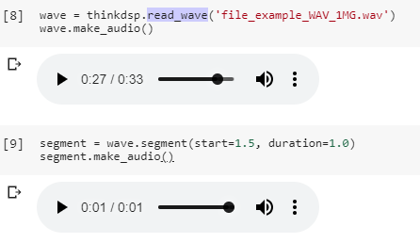
NOISE
Chang Gung University,
No.259, Wenhua 1st Rd., Guishan Dist., Taoyuan City 33302, Taiwan (R.O.C.)

Slide 11
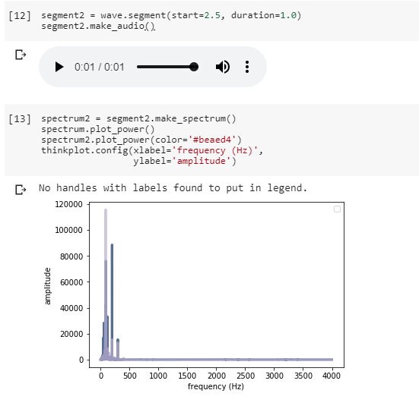
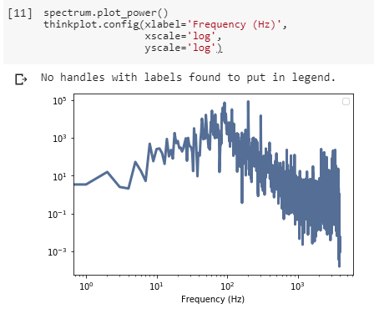
NOISE
Chang Gung University,
No.259, Wenhua 1st Rd., Guishan Dist., Taoyuan City 33302, Taiwan (R.O.C.)

Slide 12
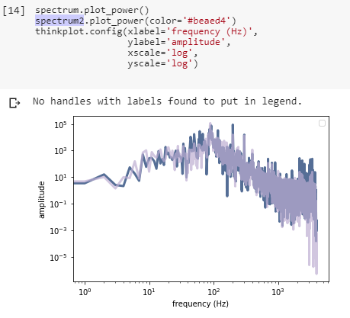
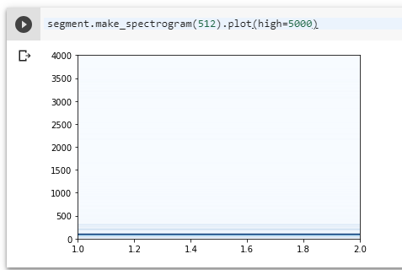
NOISE
Chang Gung University,
No.259, Wenhua 1st Rd., Guishan Dist., Taoyuan City 33302, Taiwan (R.O.C.)

Slide 13
AUTO-CORRELATION
Autocorrelation, also known as serial correlation, is the correlation of a signal with a delayed copy of itself as a function of delay. Informally, it is the similarity between observations as a function of the time lag between them.
The Jupyter notebook for this chapter, chap05.ipynb, includes an interaction that lets you compute autocorrelations for different lags. Use this interaction to estimate the pitch of the vocal chirp for a few different start times.
Chang Gung University,
No.259, Wenhua 1st Rd., Guishan Dist., Taoyuan City 33302, Taiwan (R.O.C.)

Slide 14
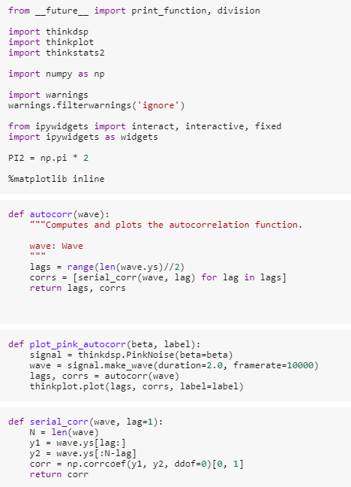
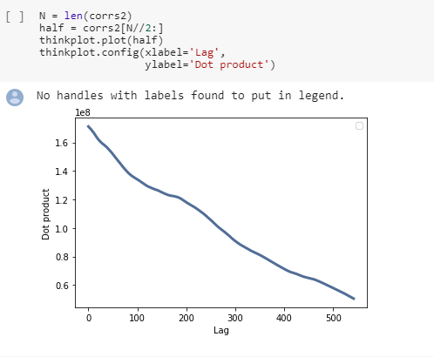
AUTO-CORRELATION
Chang Gung University,
No.259, Wenhua 1st Rd., Guishan Dist., Taoyuan City 33302, Taiwan (R.O.C.)

Slide 15
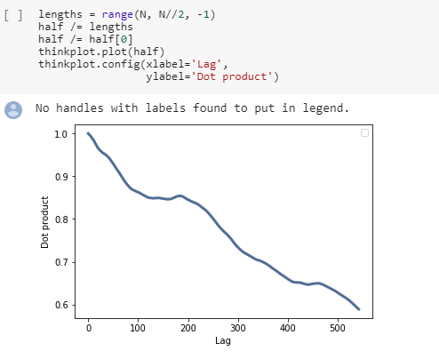
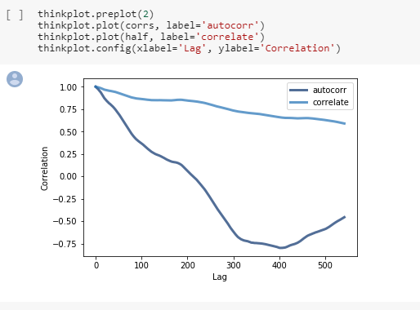
AUTO-CORRELATION
Chang Gung University,
No.259, Wenhua 1st Rd., Guishan Dist., Taoyuan City 33302, Taiwan (R.O.C.)

Slide 16
DISCRETE COSINE TRANSFORM
A discrete cosine transform (DCT) expresses a finite sequence of data points in terms of a sum of cosine functions oscillating at different frequencies.
The Jupyter notebook for this chapter, chap05.ipynb, includes an interaction that lets you compute autocorrelations for different lags. Use this interaction to estimate the pitch of the vocal chirp for a few different start times.
Chang Gung University,
No.259, Wenhua 1st Rd., Guishan Dist., Taoyuan City 33302, Taiwan (R.O.C.)

Slide 17
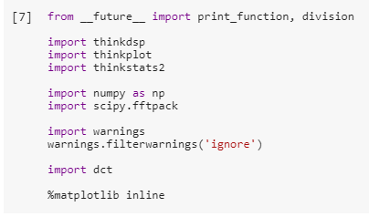
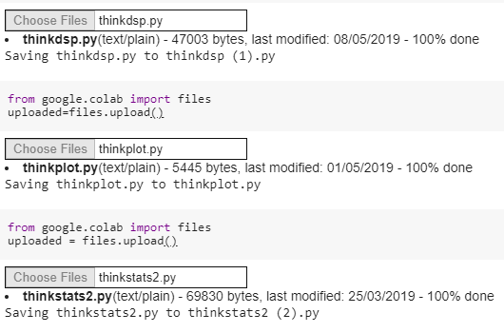
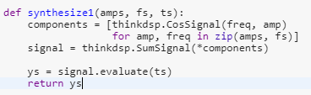
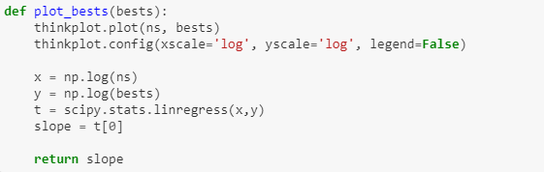
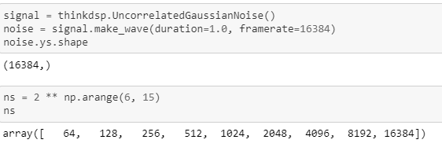
DISCRETE COSINE TRANSFORM
Chang Gung University,
No.259, Wenhua 1st Rd., Guishan Dist., Taoyuan City 33302, Taiwan (R.O.C.)

Slide 18
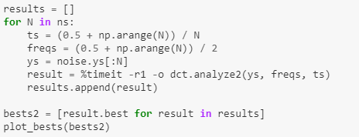
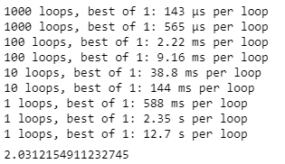
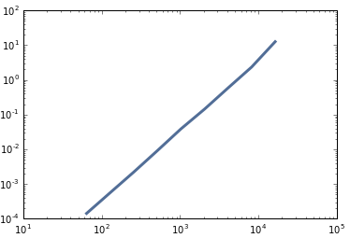
DISCRETE COSINE TRANSFORM
Analyze2 Results:
Chang Gung University,
No.259, Wenhua 1st Rd., Guishan Dist., Taoyuan City 33302, Taiwan (R.O.C.)

Slide 19
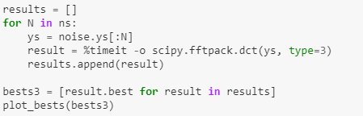
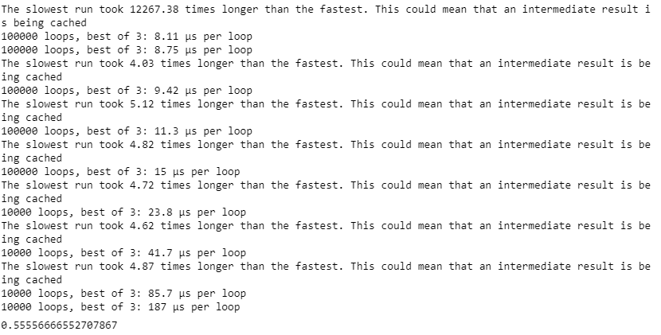
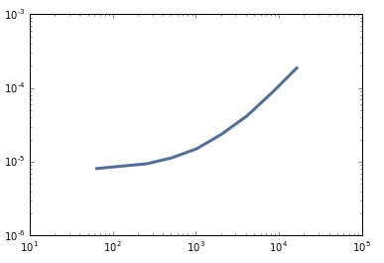
DISCRETE COSINE TRANSFORM
scipy.fftpack.dct Results:
Chang Gung University,
No.259, Wenhua 1st Rd., Guishan Dist., Taoyuan City 33302, Taiwan (R.O.C.)

Slide 20
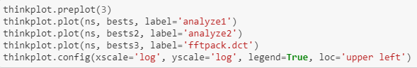
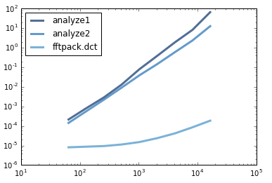
DISCRETE COSINE TRANSFORM
Summarizing and Comparing all Plots:
Chang Gung University,
No.259, Wenhua 1st Rd., Guishan Dist., Taoyuan City 33302, Taiwan (R.O.C.)

Slide 21
DISCRETE FOURIER TRANSFORM
the discrete Fourier transform converts a finite sequence of equally-spaced samples of a function into a same-length sequence of equally-spaced samples of the discrete-time Fourier transform, which is a complex-valued function of frequency.
In this chapter, I showed how we can express the DFT and inverse DFT as matrix multiplications. These operations take time proportional to N2, where N is the length of the wave array. That is fast enough for many applications, but there is a faster algorithm, the Fast Fourier Transform (FFT), which takes time proportional to N log N.
The key to the FFT is the Danielson-Lanczos lemma:
Where DFT(y)[n] is the nth element of the DFT of y; e is a wave array containing the even elements of y, and o contains the odd elements of y.
This lemma suggests a recursive algorithm for the DFT:
“Given a wave array, y, split it into its even elements, e, and its odd elements, o, Compute the DFT of e and o by making recursive calls, Compute DFT(y) for each value of n using the Danielson-Lanczos lemma”.
For the base case of this recursion, you could wait until the length of y is 1. In that case, DFT(y) = y. Or if the length of y is sufficiently small, you could compute its DFT by matrix multiplication, possibly using a precomputed matrix.
Chang Gung University,
No.259, Wenhua 1st Rd., Guishan Dist., Taoyuan City 33302, Taiwan (R.O.C.)

Slide 22
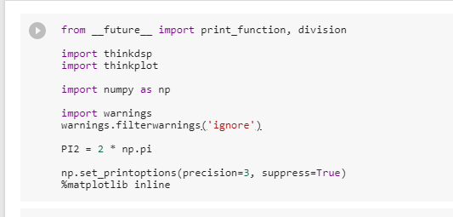
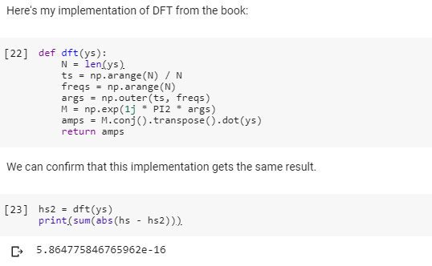
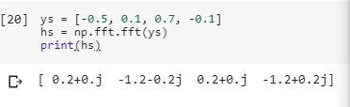
DISCRETE FOURIER TRANSFORM
Chang Gung University,
No.259, Wenhua 1st Rd., Guishan Dist., Taoyuan City 33302, Taiwan (R.O.C.)

Slide 23
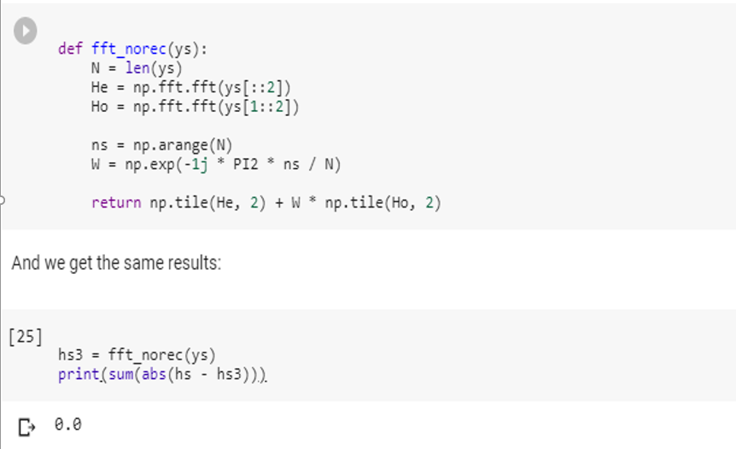
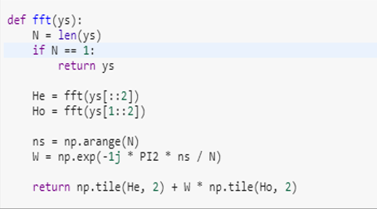
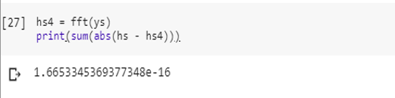
DISCRETE FOURIER TRANSFORM
Chang Gung University,
No.259, Wenhua 1st Rd., Guishan Dist., Taoyuan City 33302, Taiwan (R.O.C.)

Slide 24
My Research Area
4G LTE
5G Wireless Communication
FOCUS : Improvement on Energy Efficiency, Throughput, Channel Quality Index, SINR, RB Allocations and other related aspects.
Chang Gung University,
No.259, Wenhua 1st Rd., Guishan Dist., Taoyuan City 33302, Taiwan (R.O.C.)

Slide 25


Motivation
The increasing number of smart devices encourages the demand of high-quality video content over mobile networks.
The increasing demand of high-quality video content over mobile network is pushing telecom operators towards the design of new delivery system.
3GPP has defined Multimedia Broadcast/Multicast Service single Frequency Network (MBSFN) to enable the simultaneous transmission of the same content within multiple cells over the same radio resources with improved network scalability and spectrum efficiency.
Chang Gung University,
No.259, Wenhua 1st Rd., Guishan Dist., Taoyuan City 33302, Taiwan (R.O.C.)

Slide 26
Introduction
3GPP LTE-A provides high transmission rate upto 1Gbps and supports various broadband multimedia services, like Live IPTV, Multiuser VoIP, Live Stock Market etc.
But Such services costs extreme
System Bandwidth
Energy consumption of UE’s
Chang Gung University,
No.259, Wenhua 1st Rd., Guishan Dist., Taoyuan City 33302, Taiwan (R.O.C.)

Slide 27


Multicast Service in LTE-A
To reduce bandwidth consumption,
Multicast Group
LTE-A exploits Single-Cell eMBMS (SC-eMBMS) to enhance their transmission efficiency
for grouping multiple UEs in a multicast group if they have subscribed to the same streams.
The eNB (base station) transmits single copy of the stream data to multicast group and meet UEs' demands of the cell.
However, single-cell eMBMS incurs lower transmission rate due to inter-cell interference caused by neighbor cells.
UE₅
UE₁
UE₄
UE₂
Group₁
Group₂
UE₃
CELL
Chang Gung University,
No.259, Wenhua 1st Rd., Guishan Dist., Taoyuan City 33302, Taiwan (R.O.C.)

Slide 28
Multicast Service in LTE-A
To Avoid the inter-cell interference,
LTE-A develops Multicast-Broadcast Single-Frequency Network (MBSFN)
Which allows multiple cells to be clustered together into a bigger serving area and transmit the synchronous multicast data through CoMP (Coordinate Multipoint-Transmission) mechanism to eliminate inter-cell interference.
Single-Cell eMBMS
MBSFN
Cell 1
Cell 1
Cell 1
Cell 3
Cell 3
Cell 3
Cell 2
Cell 2
Cell 2
required subframes
required subframes
Cell₁
Service 2
Cell₁
Service 1
Service 1
Cell₂
Service 1
Cell₂
Service 2
Service 2
Cell₃
Cell₃
Chang Gung University,
No.259, Wenhua 1st Rd., Guishan Dist., Taoyuan City 33302, Taiwan (R.O.C.)

Slide 29
MBSFN Mechanism
MBSFN is managed by MCE (Multicast Coordination Entity):
MCE is a logical entity manages cell clustering and multicast scheduling for all eNBs in a MBSFN area.
Reduces inter-cell interference
MBSFN has to determine following six Parameters:
1) Area Cell 2) Area Service 3) Service MCS 4) Area Cycle 5) Area Offset 6) Service Schedule
MCE
For example:
Service 1
Service 2
Service 3
MBSFN Area 2
Service 4
MBSFN Area 1
Cell 1
Cell 1
AreaCycle = 10 (subframe)
Service_Scheduling ₁= (start, end) = (0, 1)
Cell 3
Cell 3
AreaOffset₁ = 0
10 subframes
AreaCycle₂ = 20 (subframe)
Cell 1
Cell 2
Cell 2
Cell 2
Cell 3
AreaOffset₂ = 3
Chang Gung University,
No.259, Wenhua 1st Rd., Guishan Dist., Taoyuan City 33302, Taiwan (R.O.C.)

Slide 30
Signal-to-interference-plus-noise ratio (SINR)
Analogous to the SNR used often in wired communications systems, the SINR is defined as the power of a certain signal of interest divided by the sum of the interference power (from all the other interfering signals) and the power of some background noise.
The signal power is estimated as the power of the mean response to repeated presentations of the same signal and the noise power is calculated as the average of the power in the deviation from this average in each trial.
Chang Gung University,
No.259, Wenhua 1st Rd., Guishan Dist., Taoyuan City 33302, Taiwan (R.O.C.)

Slide 31
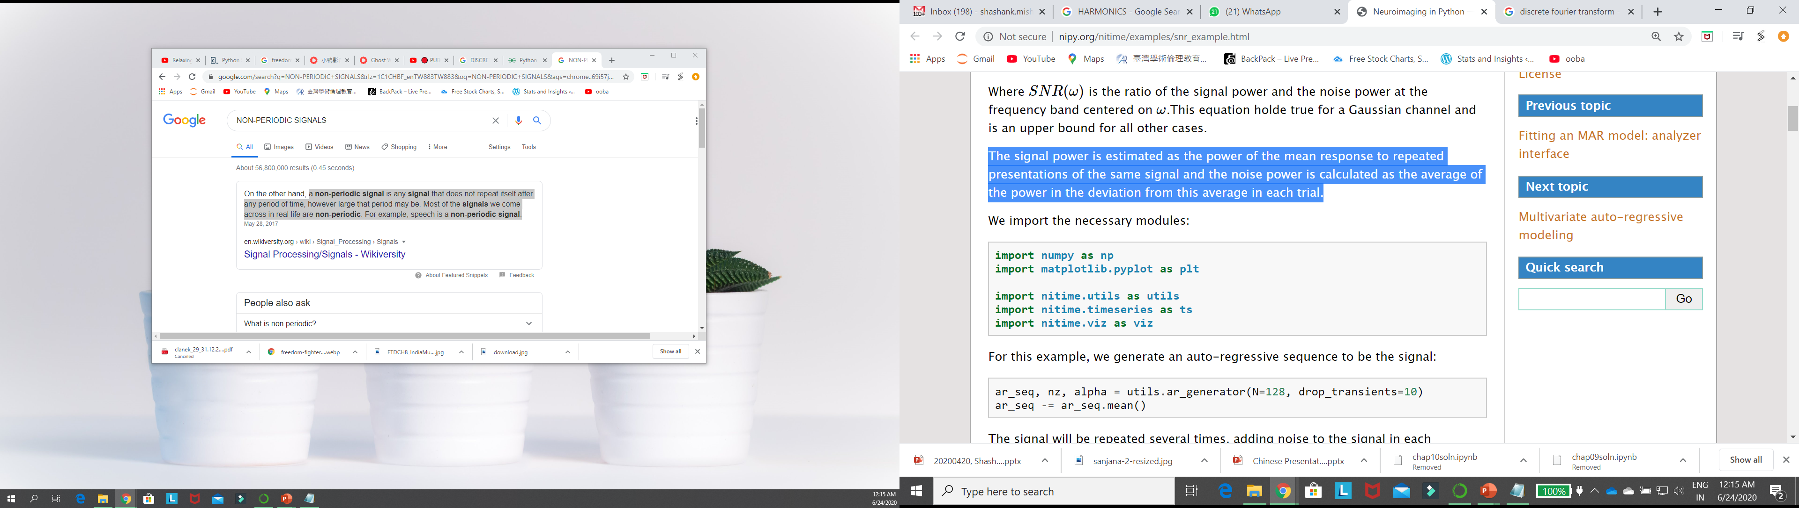
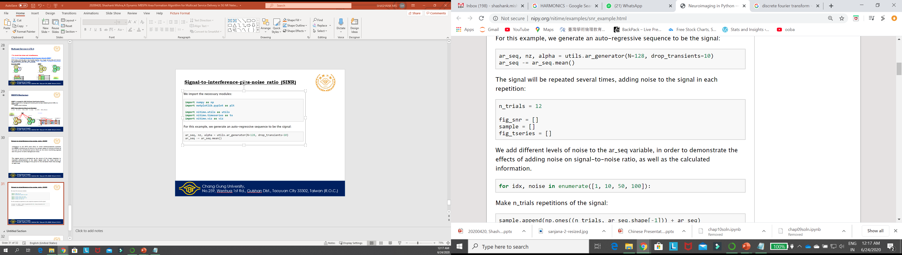
Signal-to-interference-plus-noise ratio (SINR)
Chang Gung University,
No.259, Wenhua 1st Rd., Guishan Dist., Taoyuan City 33302, Taiwan (R.O.C.)

Slide 32
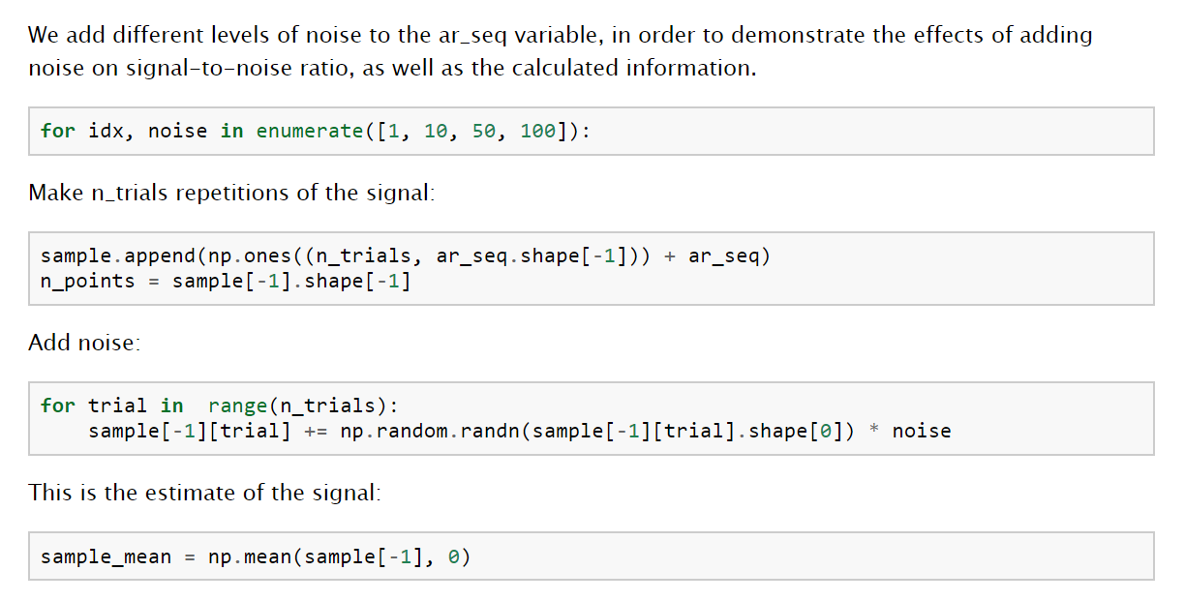
Signal-to-interference-plus-noise ratio (SINR)
Chang Gung University,
No.259, Wenhua 1st Rd., Guishan Dist., Taoyuan City 33302, Taiwan (R.O.C.)

Slide 33
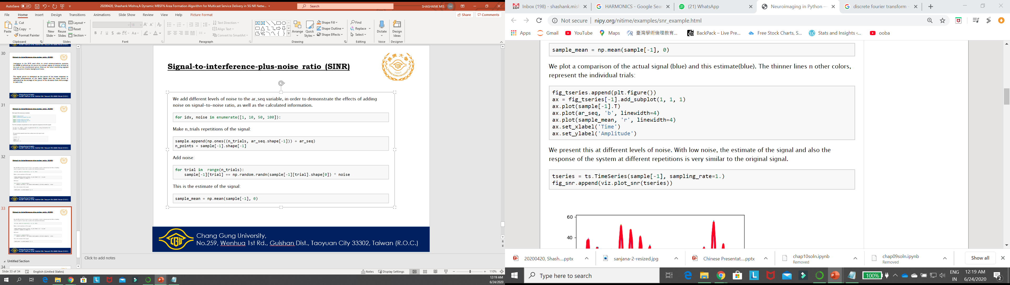

Signal-to-interference-plus-noise ratio (SINR)
A special visualization function viz.plot_snr() is used in order to display the signal power (blue) and the noise power (green), both in the left subplot. In addition, the SNR (blue) and the cumulative information (as a function of frequency bands, starting from low frequencies, in red) are displayed in the right subplot.
Chang Gung University,
No.259, Wenhua 1st Rd., Guishan Dist., Taoyuan City 33302, Taiwan (R.O.C.)

Slide 34




Signal-to-interference-plus-noise ratio (SINR)
With more added noise, the estimate of the signal deviates further from the signal.
This becomes even more apparent with more noise:
The signal power remains rather similar, but the noise power increases (across all bands). As a consequence, the signal-to-noise ratio decreases and the accumulated information decreases.
Chang Gung University,
No.259, Wenhua 1st Rd., Guishan Dist., Taoyuan City 33302, Taiwan (R.O.C.)

Slide 35


Signal-to-interference-plus-noise ratio (SINR)
Chang Gung University,
No.259, Wenhua 1st Rd., Guishan Dist., Taoyuan City 33302, Taiwan (R.O.C.)

Slide 36
Thanks…
Chang Gung University,
No.259, Wenhua 1st Rd., Guishan Dist., Taoyuan City 33302, Taiwan (R.O.C.)

